Slide 1

Decentralized Weighted Voting System
for Enterprise
Junyi Fang
001495265 fang.ju@husky.neu.edu
Yu-Chiao Huang
001442969 huang.yuc@husky.neu.edu

Slide 2
1
What is A Decentralized Voting System
Content
2
What is A Weighted Voting System
3
Why It is Valuable
4
Voting Process
5
Framework & Tools

Slide 3
1
What is a Decentralized Voting System

Slide 4

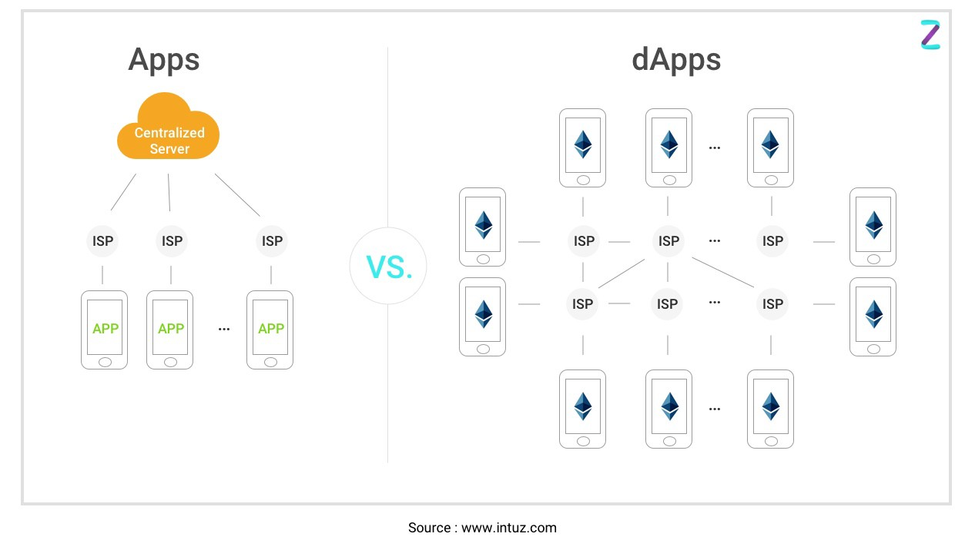
What is a Decentralized Voting System
Decentralized Application:
A computer application that runs on a distributed computing system instead of a central server
Thousands of copies on all nodes in the network; almost impossible to go down
Stored on and executed by a blockchain system
Notes:
First of all, what is a decentralized application? As it’s shown in this picture on the right
A Decentralized Application is A computer application that runs on a distributed computing system instead of a centralized server
A copy of the application can be run on hundreds or thousands of nodes in the network, making it almost impossible to go down
A Decentralized Application is Stored on and executed by a blockchain system
ISP: Internet Service Provider

Slide 5
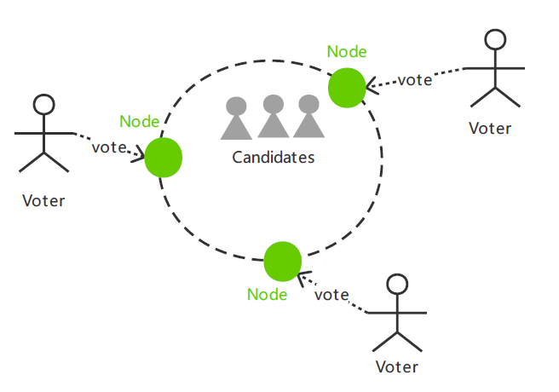

What is a Decentralized Voting System
Blockchain-based Voting System:
Users can vote in a trustless distribution environment, and each vote is recorded on the blockchain
Completely decentralized, so there is no need for any centralized institutions to collect the votes
Notes:
And what we want to implement is a Blockchain-based Voting System.
In a Blockchain-based Voting System, Users can vote in a trustless distribution environment, and each vote is recorded on the blockchain. Each user with his voting device like a mobilephone will be a node in the ethereum
A Blockchain-based Voting System is Completely decentralized, so there is no need for any centralized institutions to collect the votes
Because voting is an event of collective decision. We don’t want any other people to change our vote or a trustless third party to collect our vote and finally just come out with an voting result。 We want every vote to be unchanged and transparent. A Blockchain-based Voting System can help with that.
Weight for the vote,
Town:

Slide 6
2
What is A Weighted Voting System

Slide 7
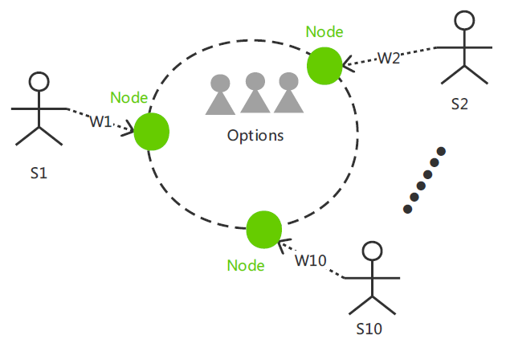
What is A Weighted Voting System
A weighted voting systems is an electoral system where votes of different voters are given different weight during the election
Option1 = 1 * W1 + 1 * W2
Option2 = 1 * W4 + 1 * W6 + 1 * W7 + 1 * W9
Option3 = 1 * W3 + 1 * W5 + 1 * W8 + 1 * W10
Final decision = Max(Option1, Option2, Option3)
Equal voting results:
Re-discuss / vote again among equal result options
Notes:
Example: shareholders voting for a decision in a company
Suppose there are 10 shareholders S1-S10 in a company, which respectively hold W1-W10 percentage of the equity
Every shareholder has only one vote for any company level decision
The proportion of the equity holding by a shareholder will be the weight of his vote
Suppose there are 3 options for a company event. The voting value for each option will be Option1 = 1 * W1 + 1 * W2; Option2 = 1 * W4 + 1 * W6 + 1 * W7 + 1 * W9 ; Option3 = 1 * W3 + 1 * W5 + 1 * W8 + 1 * W10. The final decision result will be Max(Option1, Option2, Option3)
If there are equal voting results for multiple choices:
Two options: re-discussed offline to make a final result
More than two: vote again from the options which get equal voting values

Slide 8
3
Why It is Valuable?

Slide 9

Why It is Valuable?
Transparency
Processing Time
Security
Anonymity
01
02
03
04

Slide 10
Why It is Valuable?
Transparency
Votes can be stored on a immutable public ledger, which means they can be tracked and counted and being visible to everyone
Security
Without blockchain, vote verify would be done by central bodies overseeing the process, and that cause the trust issue, but with blockchain and its decentralized ledger system, problem solved.
Anonymity
With transactions on the blockchain, voters can use their private keys to keep themselves anonymous.
Processing Time
Current voting system usually take times to collate and process answers, this would lead to time and cost issue, with blockchain, results can be gathered and processed quickly.

Slide 11
4
Voting Process

Slide 12
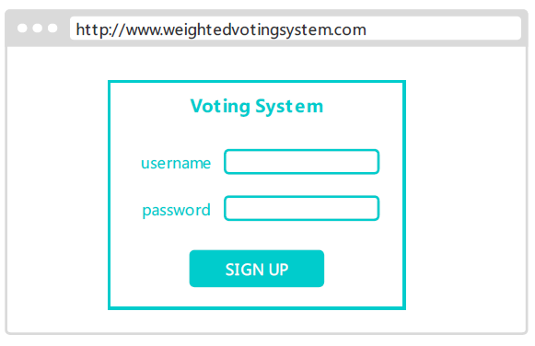
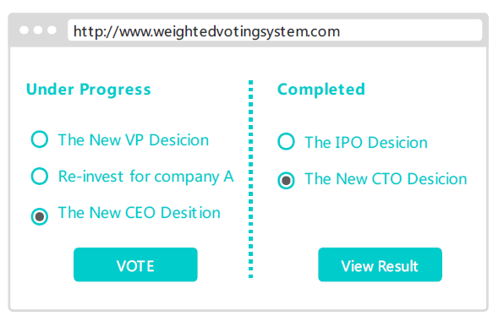
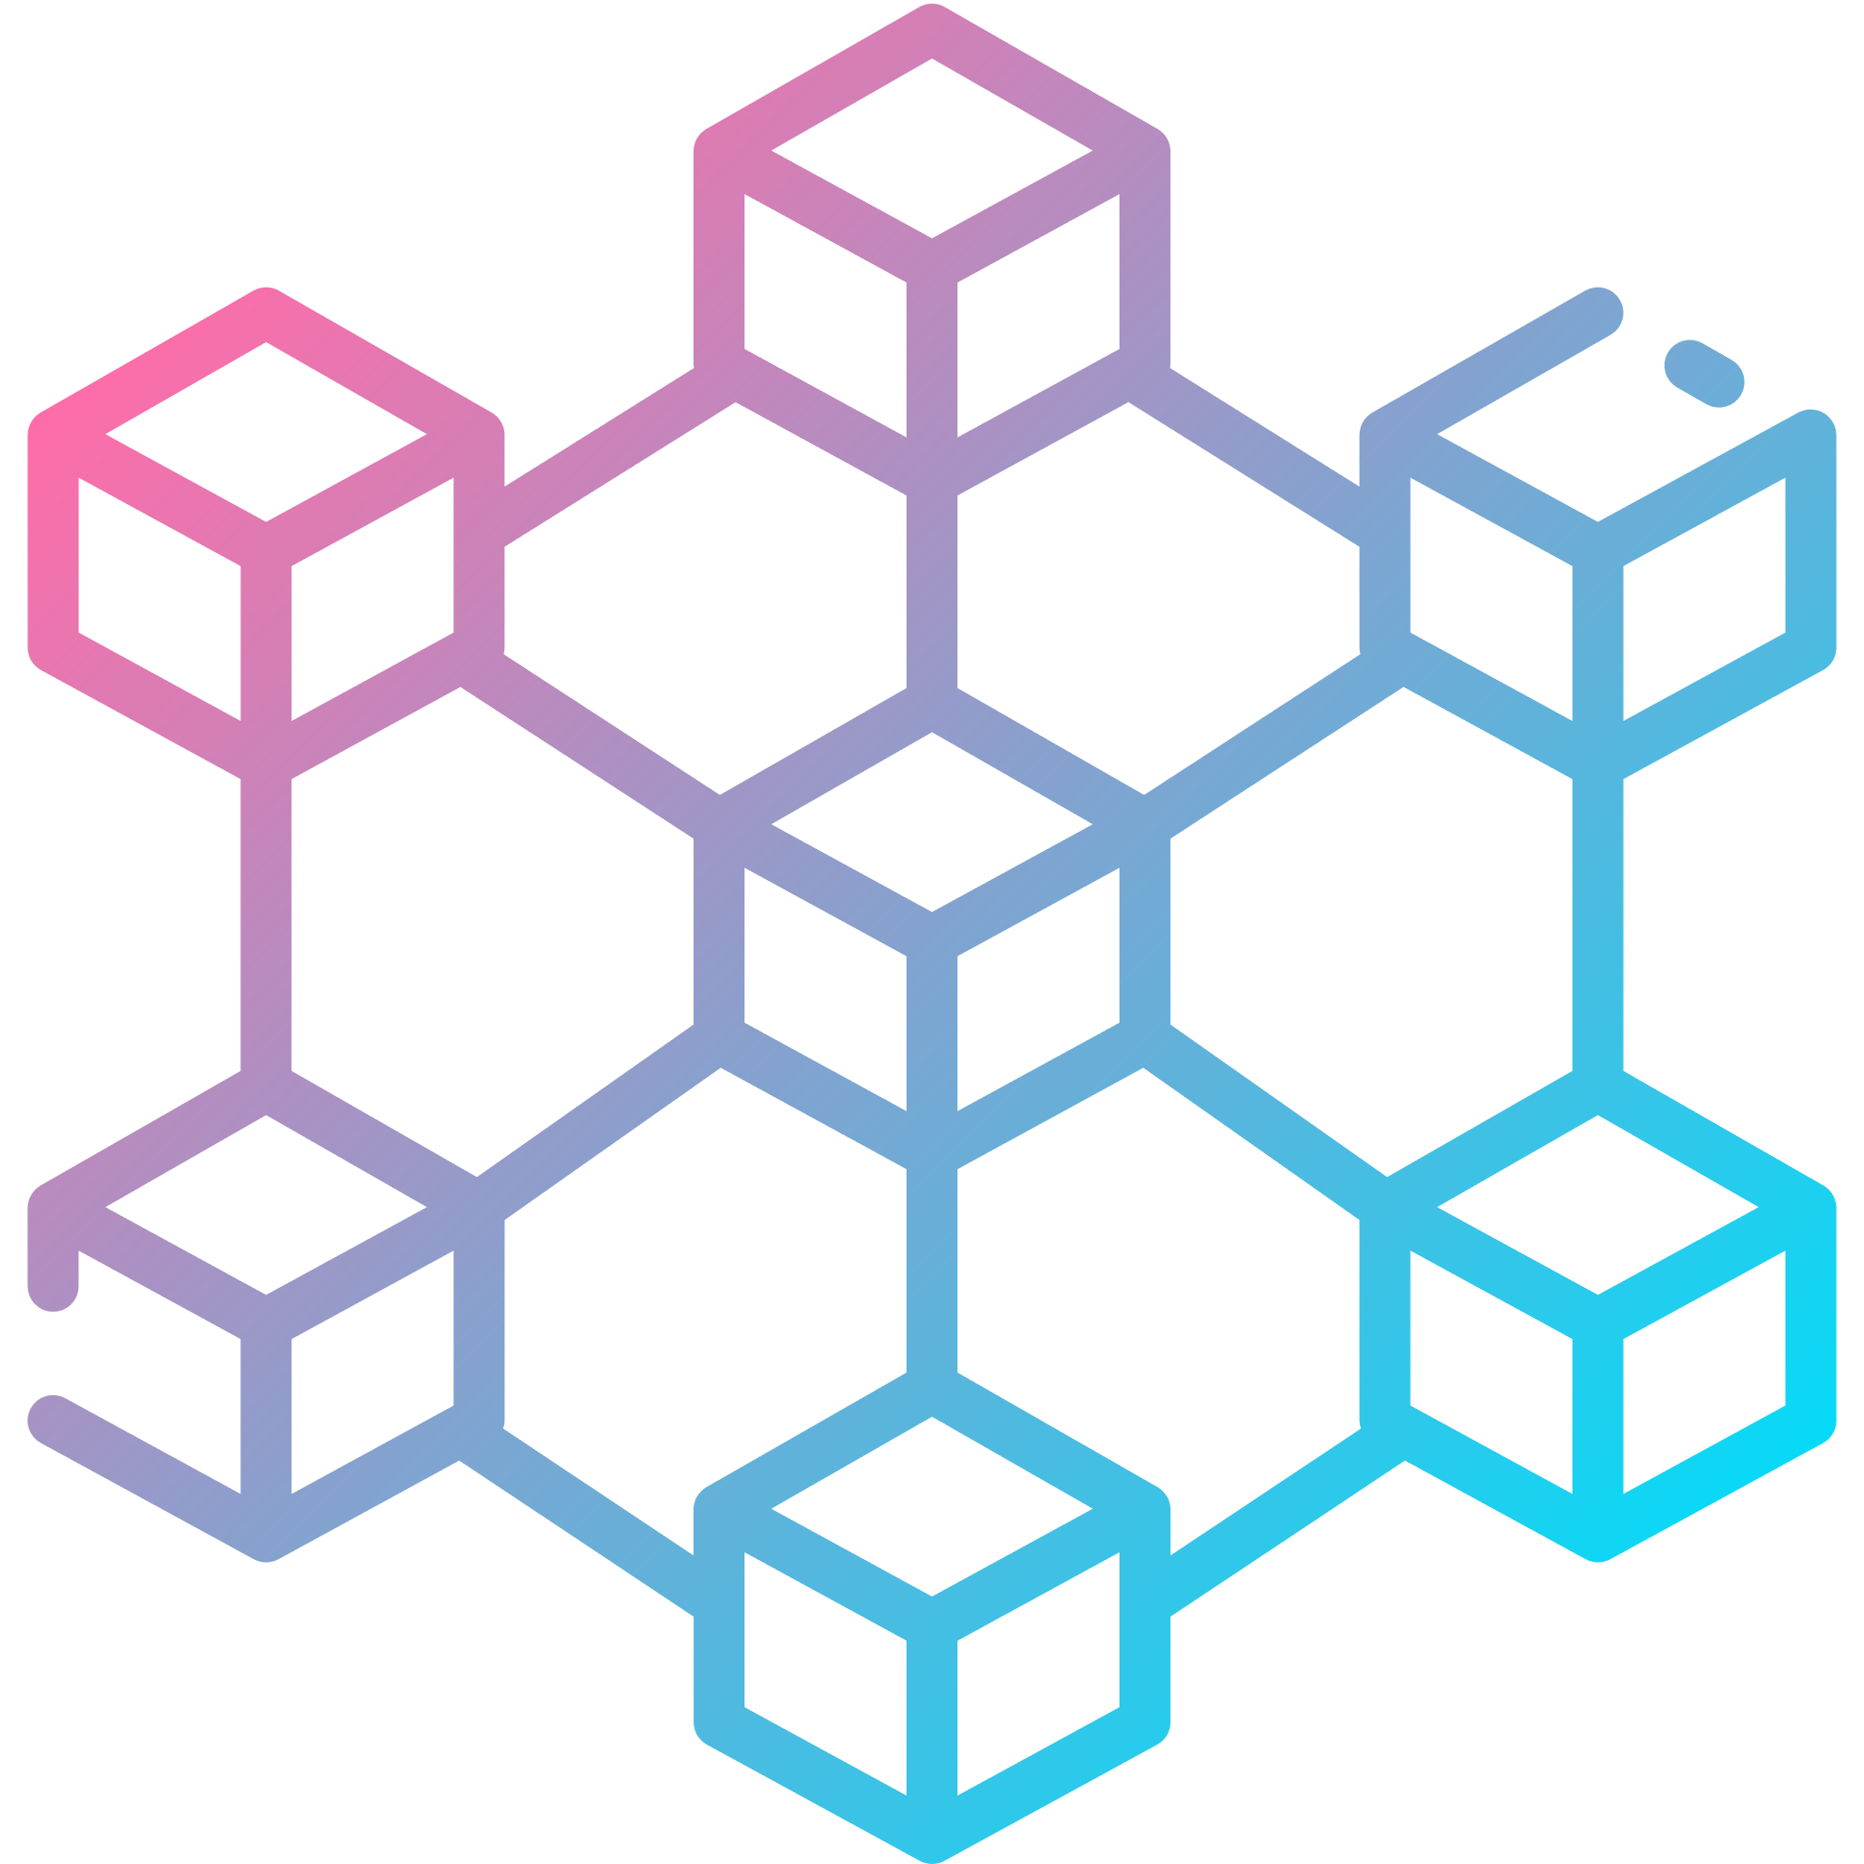
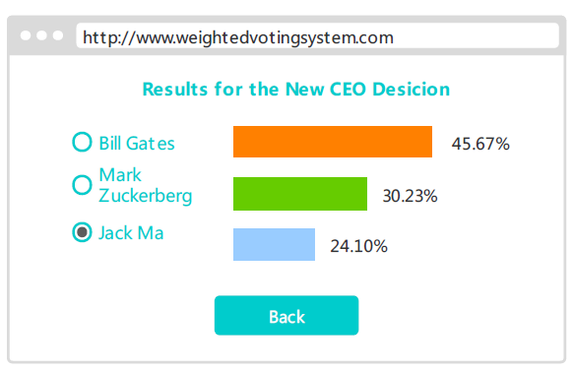
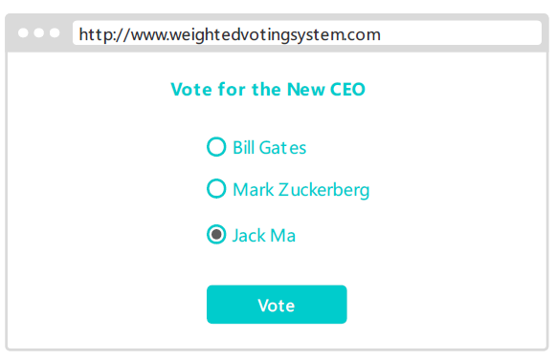
Voting Process for A User
Login the system
Request for a key pair
Verify the user
Create public/private key pair for the user
Pick an event and vote
Request for the result
Calculate the result
voting result
Check the result

Slide 13
5
Framework & Tools

Slide 14
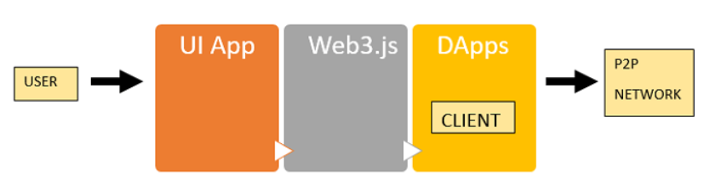


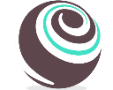



Framework & Tools
Solidity
HTML
Truffle
Weighted
Voting
System
JavaScript
Web3.js
React

Slide 15
Thank you

